Slide 1



MEAN Stack – Section 01
Mark J. Buckler
OCPJP,CIWJS

Slide 2

Credits
Some of the contents of this slide presentation have been referenced and reproduced, from MEAN Stack and MongoDB: Development Techniques, by Alexander Zanfir, ©2018 LinkedIn Corporation.

Slide 3
LEARNING OBJECTIVES
Scaffold an App with a Generator
Building an AngularJS Form
Create an Endpoint with ExpressJS
Send a Post from AngularJS
Save Data to MongoDB

Slide 4
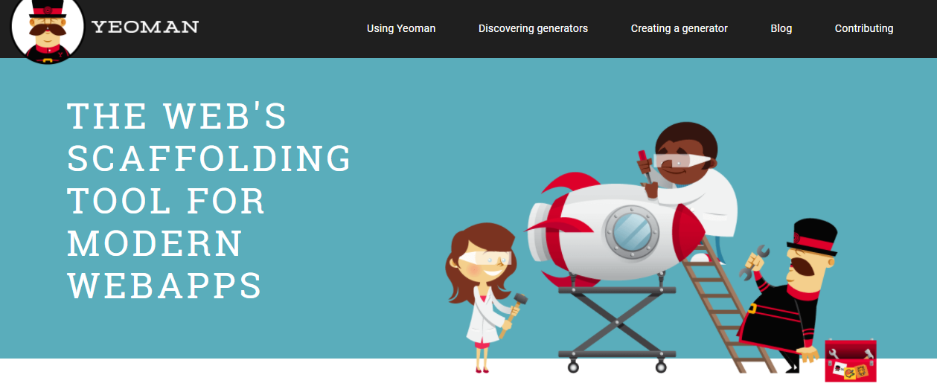
Scaffold an App with a Generator
App Generators
It is often convenient to build an entire application template with an application generator
Yeoman is very popular with many different formats: http://yeoman.io/

Slide 5
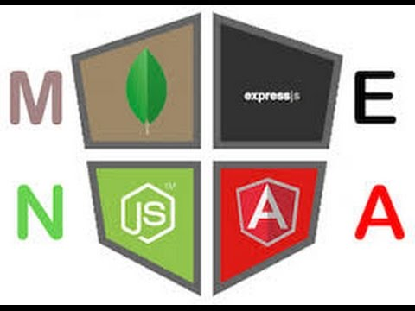
Scaffold an App with a Generator
Programming Exercise06_01_01 – Step 1
Scaffold the Application

Slide 6
Building an AngularJS Form
Programming Exercise06_01_01 – Step 2
Build an AngularJS Post Form

Slide 7
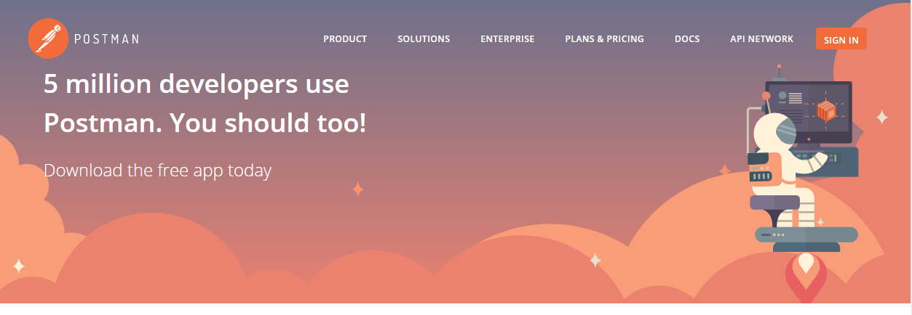
Create an Endpoint with ExpressJS
Testing with Postman
Postman is an app that will allow us to do server testing without having to use our front-end https://www.getpostman.com/apps

Slide 8
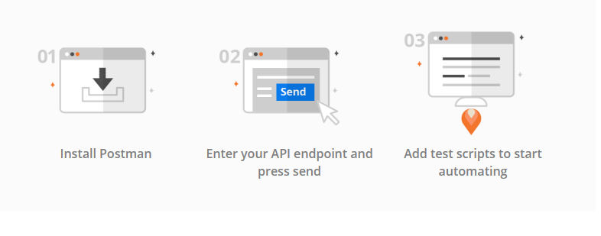
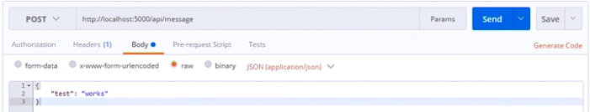
Create an Endpoint with ExpressJS
Testing with Postman

Slide 9
Create an Endpoint with ExpressJS
Programming Exercise06_01_01 – Step 3
Create a Post Endpoint with ExpressJS

Slide 10
Send a Post from AngularJS
$http Service
One of the most important services provided with AngularJS
Allows the handling of AJAX requests
Requires a server, which we have running through Gulp in this project
AJAX is asynchronous, so AngularJS covers this with Promises

Slide 11
Send a Post from AngularJS
CORS Error
Cross Origin Resource Sharing
Browser doesn’t like communicating with an API on a different URL than the Web app is being hosted on, caused possibly by
Different ports
Different URLs
Different protocols: HTTP vs. HTTPS
Solution is to enable CORES with ExpressJS
Cross Origin Resource Sharing with Express
We can use custom middleware that we define that will add the proper http headers

Slide 12
Send a Post from AngularJS
Programming Exercise06_01_01 – Step 4
Send a Post from AngularJS to the Endpoint

Slide 13
Save Data to MongoDB
Programming Exercise06_01_01 – Step 5
Saving to MongoDB from the Endpoint

